Slide 1
Credit card fraud detection using Machine Learning Techniques: A Comparative Analysis

Slide 2
Flow of Talk
Introduction
Experimental Set Up and Methods
Conclusion
References

Slide 3
Introduction
Fraud can be defined as criminal deception with intent of
acquiring financial gain.
Credit Card Fraud
➢ Inner Card Fraud: Done by using false identity
➢ External Card Fraud: Done by using stolen credit card
How Frauds are Recognized
➢ Location: Purchase made from different location
➢ Items you buy: If you deviate from your regular buying pattern or time
➢ Frequency: Make a large number of transactions in short period of time
➢ Amount: Suddenly if the costly items are purchased

Slide 4
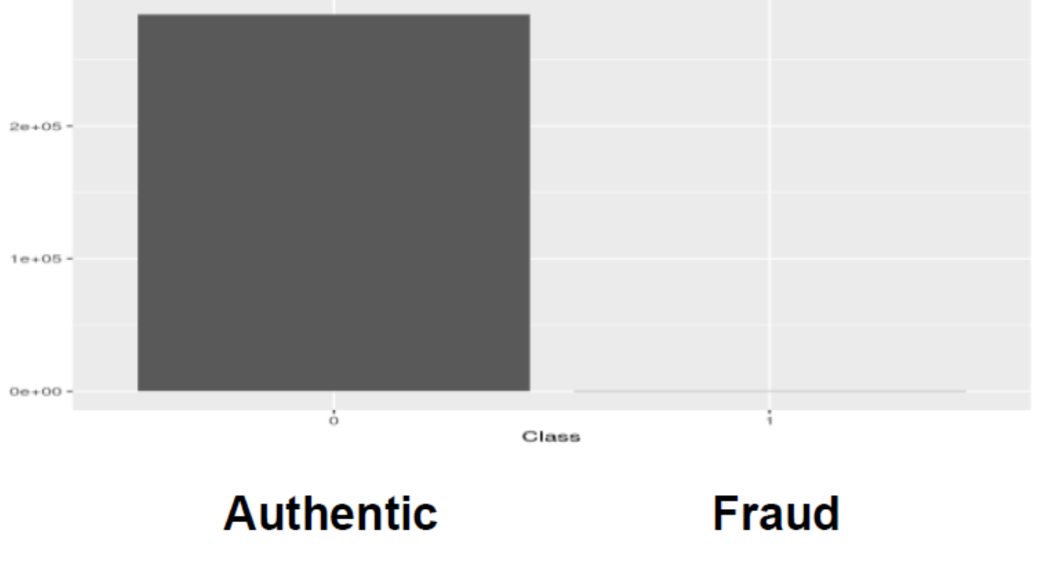
Challenges:
➢The data is highly skewed.
➢Normal Machine Learning algorithms would give 99%+ Accuracy.
➢But we can get 99.8% accuracy even if we classify all Frauds as
Legitimate.
Fig 1. Highly Unbalanced data

Slide 5
Feature (Variables) Selection
➢ Transaction statistics
➢ Regional statistics
➢ Merchant type statistics
➢ Time based amount statistics
➢ Time based number of transaction statistics
Credit Card Fraud Detection
➢ Supervised: Models are estimated based on samples of
fraudulent and legitimate transactions to classify new transactions
as fraud or legitimate.
➢ Unsupervised: The outliers’ transactions are considered as
potential instance of fraud.
Comparative Study

Slide 6
Experimental Set Up and Methods
Dataset
➢Sourced from ULB Machine Learning Group
➢Consisting 2,84,807 transactions , 0.172% fraud cases
➢ Highly Unbalanced and Skewed towards fraud class
Resampling Methods
➢ The resampling methods are used to adjust the class
distribution of the data as the minority class is not equally
represented.
➢ There are three methods to perform resampling :
Oversampling
Undersampling
Hybrid Sampling

Slide 7
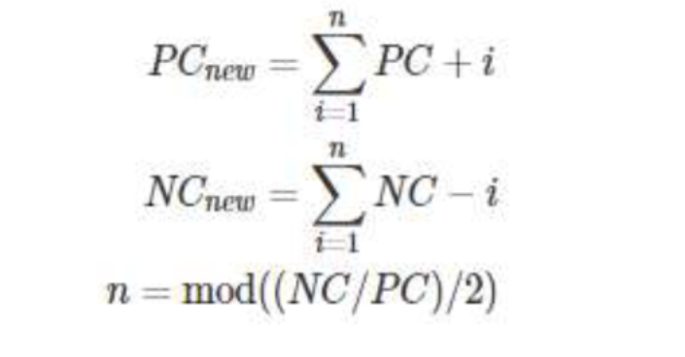
SMOTE :
➢ SMOTE stands for Synthetic Minority Oversampling Technique.
➢ This is a statistical technique to increase the number samples in
the minority class in the dataset to make it balanced.
➢ It works by generating new instances of data from existing data
by taking feature space of each target class and its nearest
neighbours.
➢ But it is effective upto 6 to 7 parameters.
Hybrid Sampling of data:
➢ It is done by stepwise addition and subtraction of data points
interpolated between existing data points till the overfitting
threshold is reached.

Slide 8
k-Nearest Neighbour Classifier
➢ K - Nearest neighbors is a lazy learning instance based
classification( regression ) algorithm which is widely
implemented in both supervised and unsupervised learning
techniques.
➢ It is lazy Learner as it doesn't learn from a discriminative
function from training data but memorizes training dataset.
➢ This technique implements classification by considering
majority of vote among the “k” closest points to the
unlabeled data point.
➢ It uses three types of functions for distance calculation
➢ Euclidian
➢ Manhattan
➢ Minkowski

Slide 9
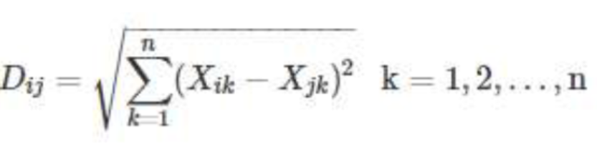
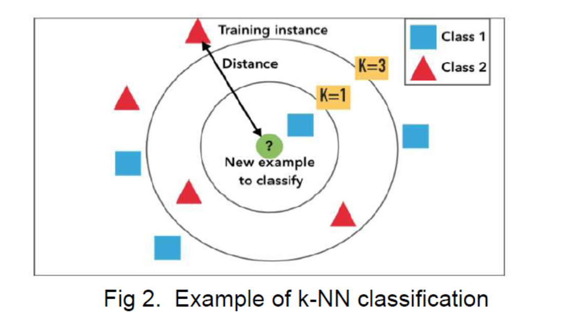
k-Nearest Neighbour Classifier
Formula to calculate Euclidean distance

Slide 10
Decision Tree Induction algorithm
A Decision tree algorithms are a method for approaching discrete-valued target functions, in which the learned Function is denoted by a decision tree. These types of algorithms are famous in inductive learning and have been successfully applied to abroad range of tasks. We examine the decision tree learning algorithm – ID3.The decision tree is a structure that contains root node, branch and leaf node. Every internal node indicates a test on attribute, every branch indicates the outcome of test and each leaf node holds the class tag. The uppermost node in the tree is the root node .A Decision trees organize circumstances by sorting them down the tree from the root to some leaf node, which delivers the classification of the instance. Each node in the tree specifies a test
of some attribute of the instance and each branch descending from that node links to one of the possible values for this attribute. For example figure below explains a decision tree based on attribute name outlook.

Slide 11
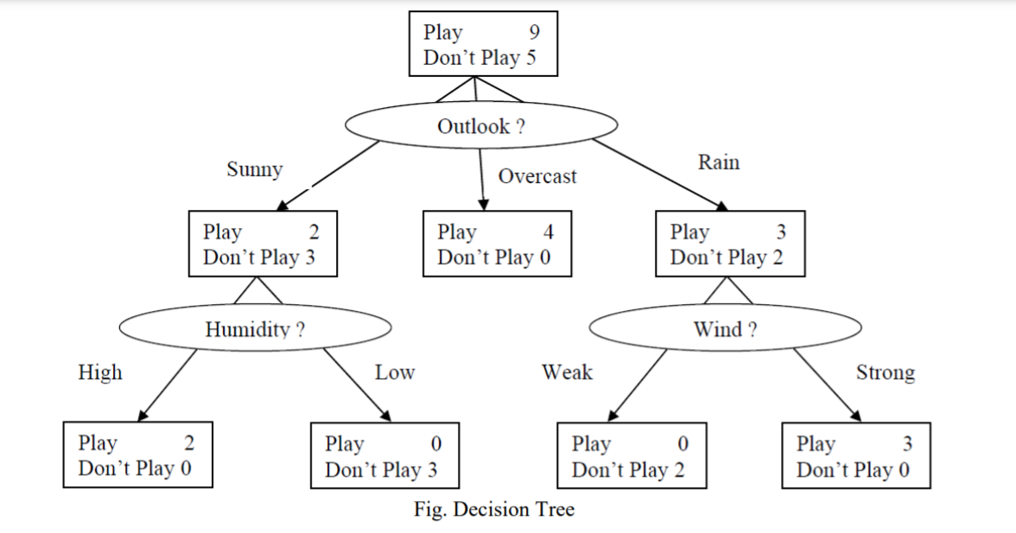
Entropy
The entropy is a measure in the information theory, which illustrates the impurity of an arbitrary collection of examples. For e.g. if training data has 14 instances with 6 positive and 8 negative instances, the entropy is calculated as
Entropy ([6+, 8-]) = −(6 /14) log2 (6 /14) − (8/14) log2 (8/14) = 0.985
A key point to reminder here is that the more uniform is the probability distribution, the greater is its entropy.1.2 Information gain The information gain measures the likely reduction in entropy by partitioning the examples according to the attribute.

Slide 12
Conclusion
Classifiers based on different machine learning techniques ( K-nearest neighbours and Decision Tree) are trained on real life of credit card transactions data and their performances on credit card fraud detection valuated and compared based on several relevant metrics.
The highly imbalanced dataset is sampled in a hybrid approach where the positive class is oversampled and the negative class under-sampled, achieving two sets of data distributions.
The performances of the classifiers are examined on the two sets of data distributions using accuracy, sensitivity , specificity, precision, balanced classification rate and Matthews Correlation coefficient metrics.
Results from the experiment shows that the KNN shows significant performance for all metrics evaluated except for accuracy in the 10:90 data distribution.

Slide 13
References :
www.geekforgeeks.org
ieeexplore.ieee.org
www.researchgate.net

Slide 14
Thank
You

